Slide 1

Credit Card Default Analysis
Insights and Predictive Modeling

Slide 2
Problem Statement
Objective: Develop a predictive model to assess credit card default risk using data from April to September 2005.
Methods: Utilize advanced statistical techniques and in-depth demographic and credit data analysis.
Process:
Rigorous data cleaning
Comprehensive exploratory analysis
Detailed model evaluation
Impact: Enhance decision-making for credit card companies and provide a basis for future research in risk assessment.

Slide 3
Dataset Overview
Demographic Variables: Gender, education level, marital status.
Repayment Status: Monthly records from April to September.
Bill Amounts: Monthly statements for each account.
Previous Payments: Amounts paid by the account holder each month.
Credit Limit: Maximum credit allowed on the card.

Slide 4
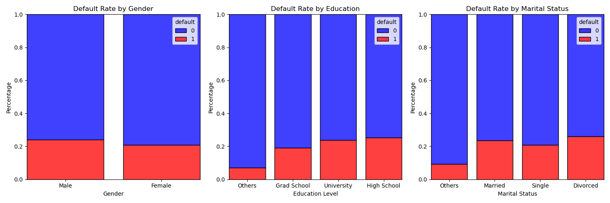
Demographics Analysis
Females have a slightly lower default rate than males, suggesting minor differences in financial behavior by gender.
Higher default rates are seen in those with university-level education compared to graduates, indicating varying financial stability across education levels.
Married individuals show the highest default rates, potentially reflecting financial pressures linked to marital responsibilities.

Slide 5
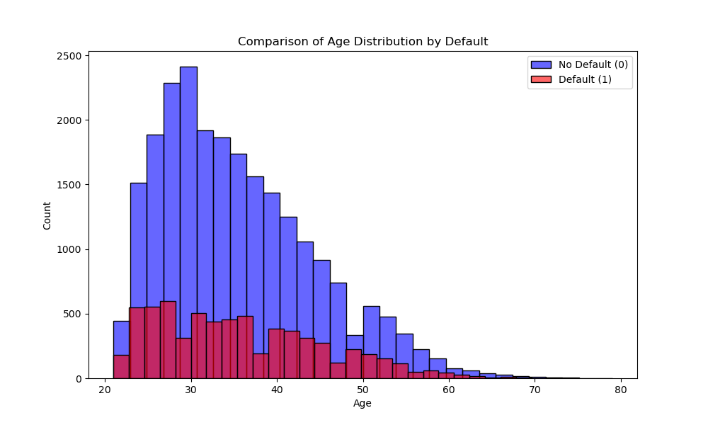
Age Distribution
Majority of clients aged between 20-40, with highest default rates in mid-20s to early 30s.
Younger clients demonstrate greater credit usage, significantly represented in both default and non-default groups.
Older age groups show fewer defaults, indicating lower risk and possibly decreased credit usage with age.

Slide 6
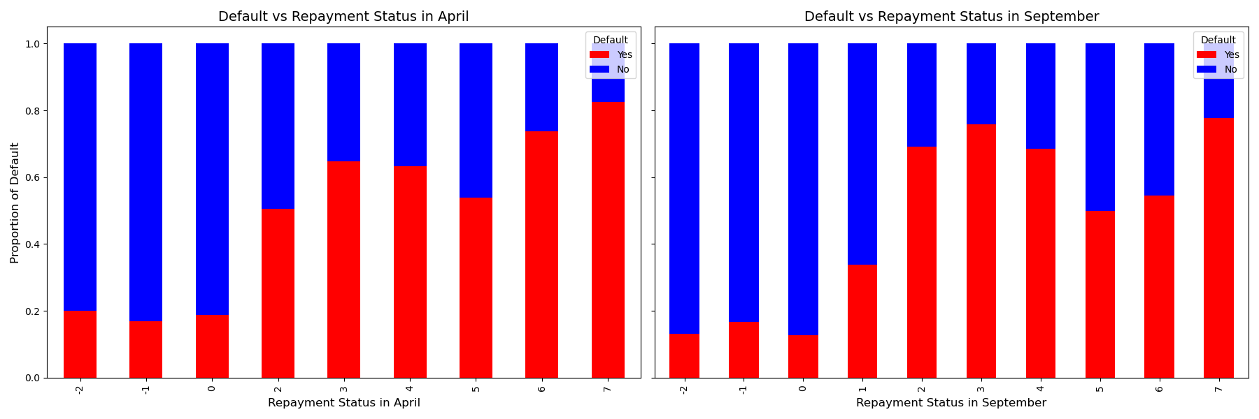
Repayment Status Analysis
Late payments significantly increase default risk
Early and on-time repayments are consistently associated with lower default rates.
Repayment behavior shows consistent patterns over time, suggesting that past payment behaviors can be reliable indicators of future creditworthiness.

Slide 7
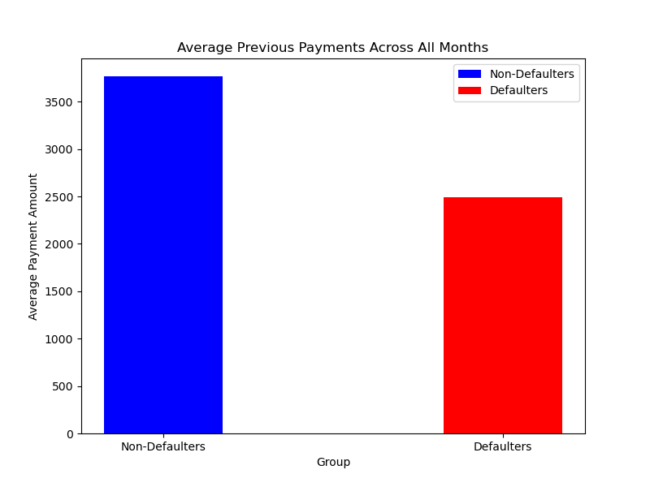
Previous Payments Analysis
Higher Payments Associated with Lower Default Risk: The graph clearly shows that higher average payments are linked with a lower likelihood of default.
Payment Behavior as a Risk Indicator: The noticeable difference in average payments between the two groups can serve as a strong indicator of potential default risk.

Slide 8
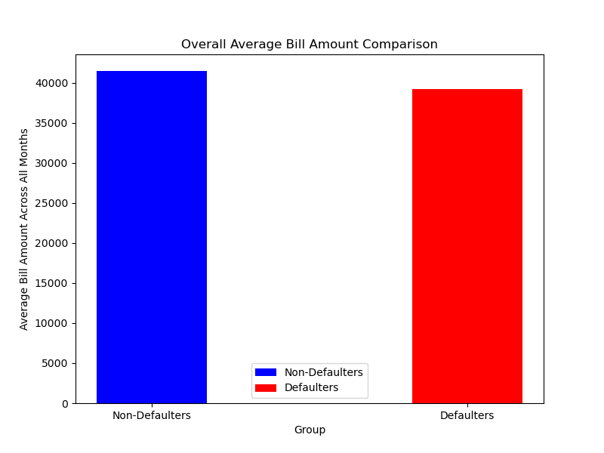
Bill Amount Analysis
The distribution of bill amounts reveals wide variability, indicating that high bill amounts alone may not be a definitive indicator of default risk.

Slide 9
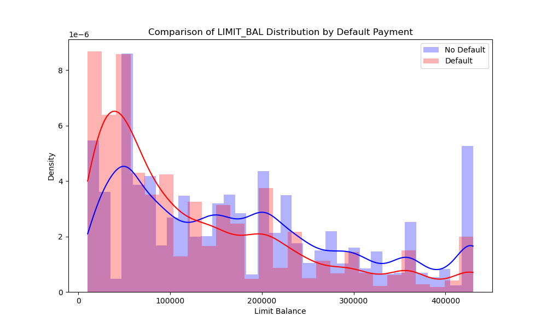
Credit Limit Analysis
Lower credit limits are associated with a higher risk of default, highlighting credit limit as a significant factor in assessing default risk.

Slide 10

Modeling Approach
Various machine learning models were employed to predict credit card default risk, each offering unique insights into the data patterns.
Logistic Regression: Insights into its baseline performance and limitations in capturing complex nonlinear relationships.
Decision Tree and Random Forest: Analysis of their ability to handle nonlinear relationships and the ensemble approach to reduce overfitting.
Gradient Boosting: Highlighting its superior performance, particularly in balancing precision and recall.
Photo by Eduardo Rincon on Unsplash

Slide 11
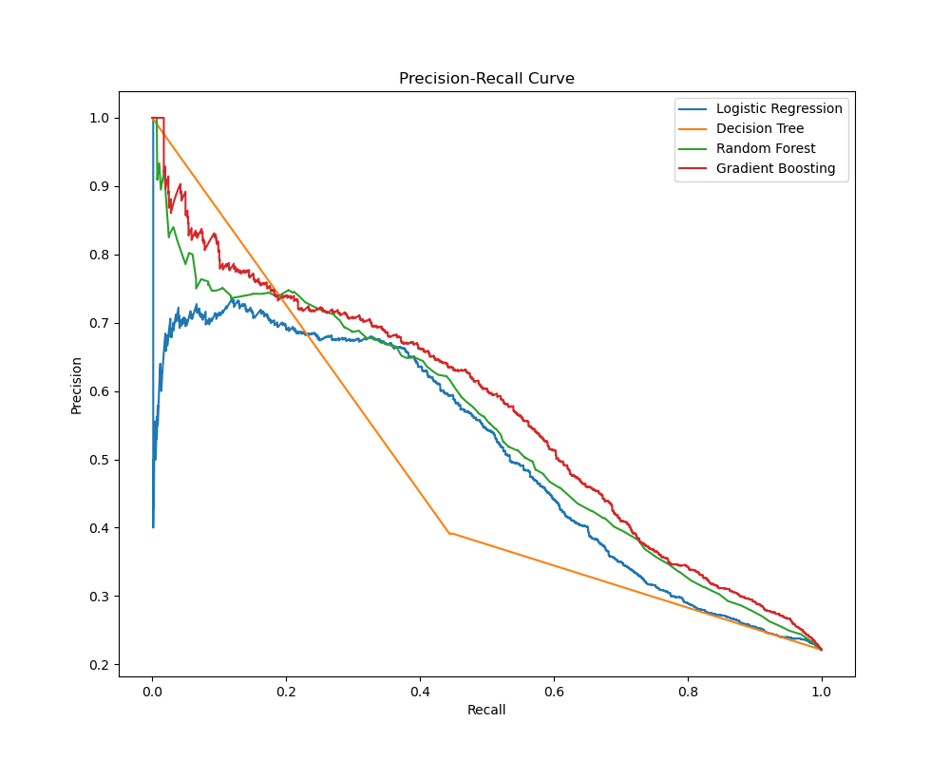
Model Performance
Random Forest appears to be one of the best models, offering a consistent and strong balance between precision and recall.
Gradient Boosting also stands out, maintaining a steadier trade-off between precision and recall as it seeks to identify more positive cases.

Slide 12
Key Takeaways
Risk Management: Advanced models offer precise default predictions, enabling proactive risk mitigation and enhancing the institution's financial stability.
Operational Efficiency: Automation of risk assessments streamlines decision-making, optimizing the use of human resources for complex cases.
Financial Performance: Early detection capabilities minimize losses from defaults, identify opportunities for growth, and improve profitability.
Customer Experience: Tailored credit products and early intervention strategies enhance customer satisfaction and loyalty.
Strategic Decision-Making: Data-driven insights from predictive models inform strategic initiatives, promoting market expansion and product innovation.

Slide 13
Future Work
Enhanced Model Accuracy: Continuous data collection and algorithm refinement will lead to more accurate, insightful risk assessments and proactive measures.
Technological Advancements: Integration of AI and machine learning will enable models to adapt in real-time, personalizing risk management strategies.
Innovation in Financial Services: Predictive models will increasingly intersect with broader financial products, offering customers comprehensive management experiences and attracting new clientele with data-driven services.
Adaptability and Compliance: As the financial landscape evolves, these models will provide the agility needed to stay ahead in regulatory and market changes, ensuring responsible credit management practices.

Slide 14
Thanks for your attention

